Slide 1
Construction status and future plan for RAON and its nuclear data production system
Moses Chung (UNIST)
Seung-Woo Hong (Sungkyunkwan University)
2019 Symposium on Nuclear Data

Slide 2
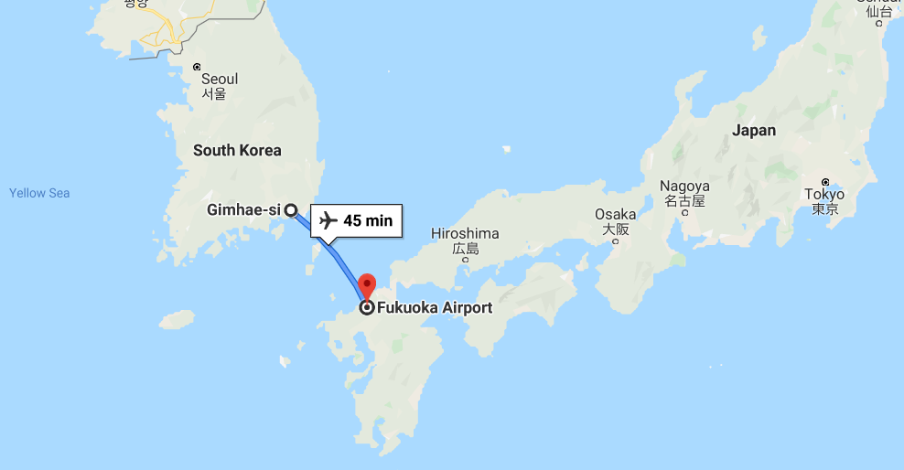
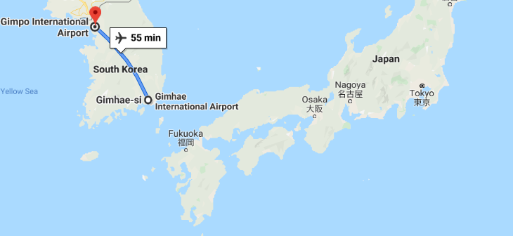
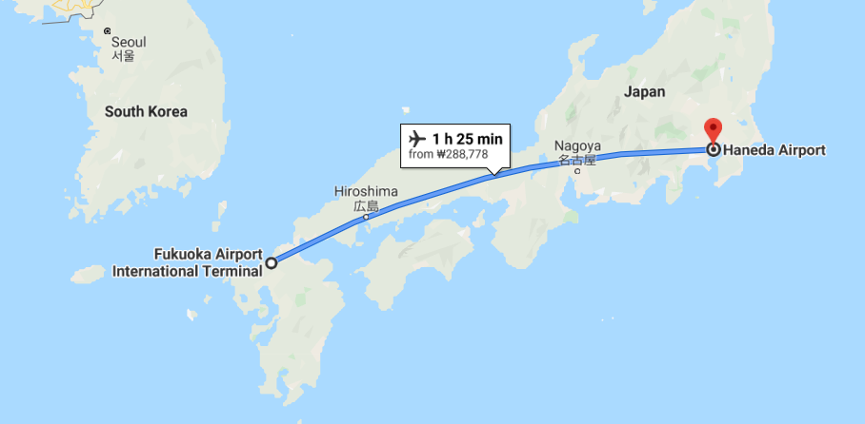
We’re much closer than expected
VS

Slide 3
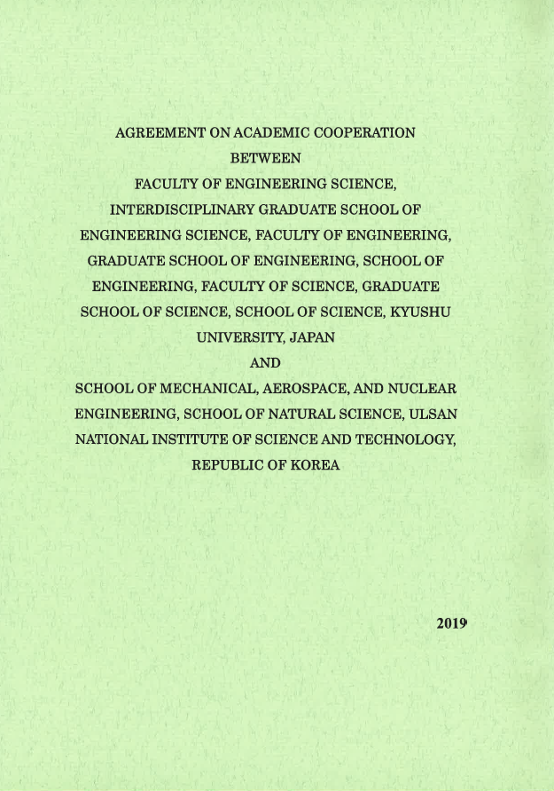
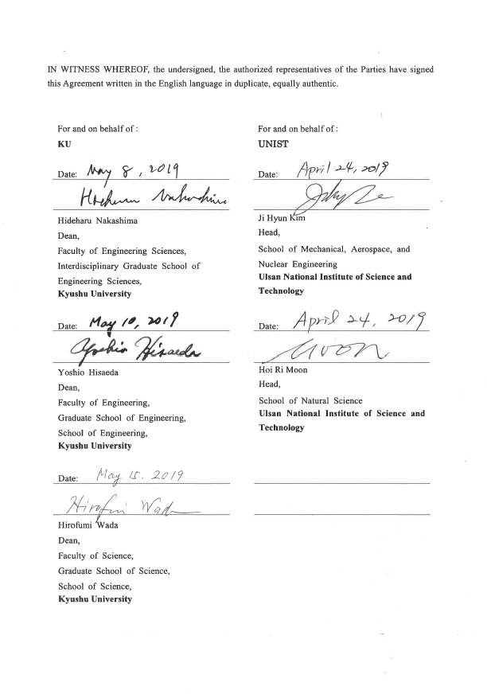
MOU between Kyushu Univ. and UNIST

Slide 4
Contents
Overview of RAON under construction by RISP
RISP : Rare Isotope Science Project
RAON : 라온/Rah On/ (backronym)
Rare isotope Accelerator complex for ON-line experiment
Nuclear Data Production System (NDPS) in RAON
Summary

Slide 5
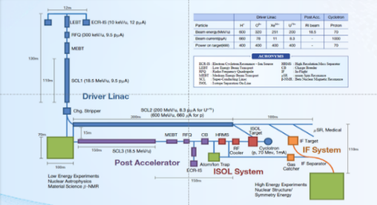
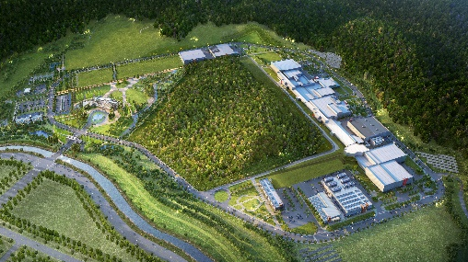
Rare Isotope Science Project (RISP)
1. Overview
Goal: To build a heavy ion accelerator complex RAON,
for rare isotope science research in Korea.
* RAON - Rare isotope Accelerator complex for ON-line experiments
Period: 2011.12 ~ 2021.12
System Installation Project
Providing high intensity RI beams by ISOL and IF
ISOL: direct fission of ²³⁸U by 70 MeV proton
IF: 200 MeV/u ²³⁸U (intensity: 8.3 pμA)
Providing high quality neutron-rich beams
e.g., ¹³²Sn with up to 250 MeV/u,
up to 10⁹ particles per second
Providing More exotic RI beam
production by combination of ISOL and IF
Development, installation, and commissioning of the accelerator systems that provides high-energy (200MeV/u) and high-power (400kW) heavy-ion beam
Facility Construction Project
Construction of research and support facility to ensure the stable operation of the heavy-ion accelerator, experiment systems, and to establish a comfortable research environment
※ Accelerator and experiment buildings, support facility, administrative buildings, and guest house, etc.
Slide of M. Kwon

Slide 6
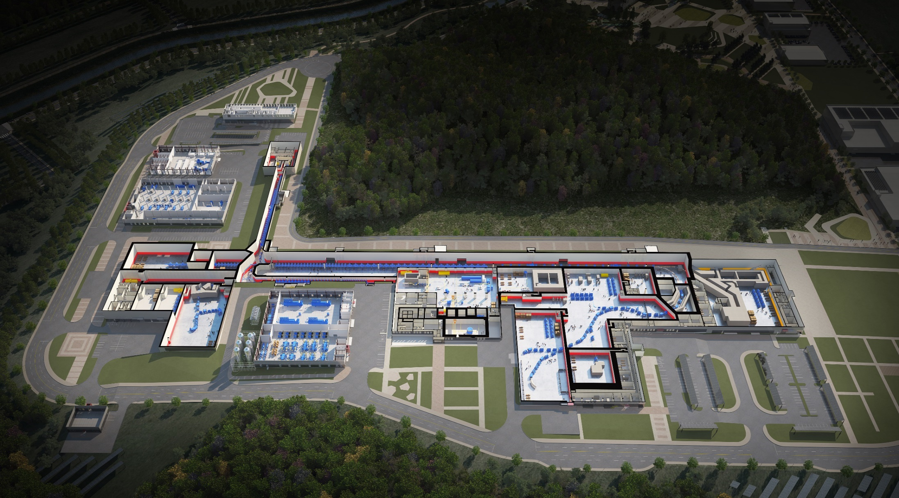
RAON Layout
1. Overview
Control
Center
Utility
SCL1
ISOL System
HPMMS/
CLS
IF System
SCL3
SCL2
BIS
ECR IS
μSR
NDPS
KOBRA
Cyclotron
HRS
LAMPS
SCL1 has been decided to postpone
: SCL3 is going to be taking a role of SCL1 in the early operation
Slide of M. Kwon

Slide 7
1. Overview
RIBs at RAON
IF
ISOL
KOBRA
ISOL+IF
RAON will provide access to unexplored regions of the nuclear chart
“More exotic, more intense, more various RIBs”
Slide of M. Kwon

Slide 8
1. Overview
Project History
System Installation
Facility Construction
Project General
Jan 2012 Established Master Plan for RISP
Dec 2014 Began the basic design of facility
construction
June 2016 Constructed the
SRF test facility
at Munji
March 2018
Completed
the SCL3 HWR
prototype module
performance test
2011
2012
2013
2014
2015
2016
2017
2018
2018
2019
Feb 2011
Completed the Heavy-ion
Accelerator Conceptual Design
Dec 2011
Launched the Heavy-in
Accelerator Project
June 2013 Completed Technical Design
Report (TDR)
Sep 2013 Revised the Master Plan (1st)
(period extension (~2019),
implementation schedule
change, etc.)
April 2015 Revised the Master Plan (2nd) (period extension (~2021), implementation strategy change, etc.)
Dec 2015 Completed the basic design of facility construction
Sep 2017 Began the facility
construction
Oct 2017 Successfully completed the
SCL demo runs
Dec 2017 Project review by TF
May 2019 Revised the Master Plan (3rd) (scope and strategy change)
Sep 2019
Install the first QWR module
Slide of M. Kwon

Slide 9
1. Overview
Project Milestone
(2018)
SCL3 manufacturing
SCL2 Prototype
(2019)
SCL3 Installation
SCL2 manufacturing
(2020)
SCL3 Beam Commissioning/
Const. Completion
(2021)
KOBRA operation/
Project Completion
System Installation
ECR-IS beam &
ISOL beam (SI beam)
(Dec 2015)
18.5MeV/u
SI beam
(Dec 2020)
18.5MeV/u
RI beam
(Sep 2021)
SCL demo beam
(Dec 2017)
2014
2015
2016
2017
2018
2019
2020
2021
RFQ beam
(Dec 2016)
SCL
installation
(April 2019)
ISOL
Commissioning
(July 2020)
D-1
Experiment
(Jan 2021)
SCL2
(Dec 2021)
Facility Construction
Completion of basic design
(Dec 2015)
Completion of detail design
(June 2017)
Supply of utilities
(Dec 2018)
Building
Permit
(April 2021)
2014
2015
2016
2017
2018
2019
2020
2021
Beginning of priority
construction
(Feb 2017)
Beginning of construction
(Sep 2017)
Completion of construction
(Aug 2020)
Completion of inspection of the radiation facility
(Dec 2021)
Slide of M. Kwon

Slide 10
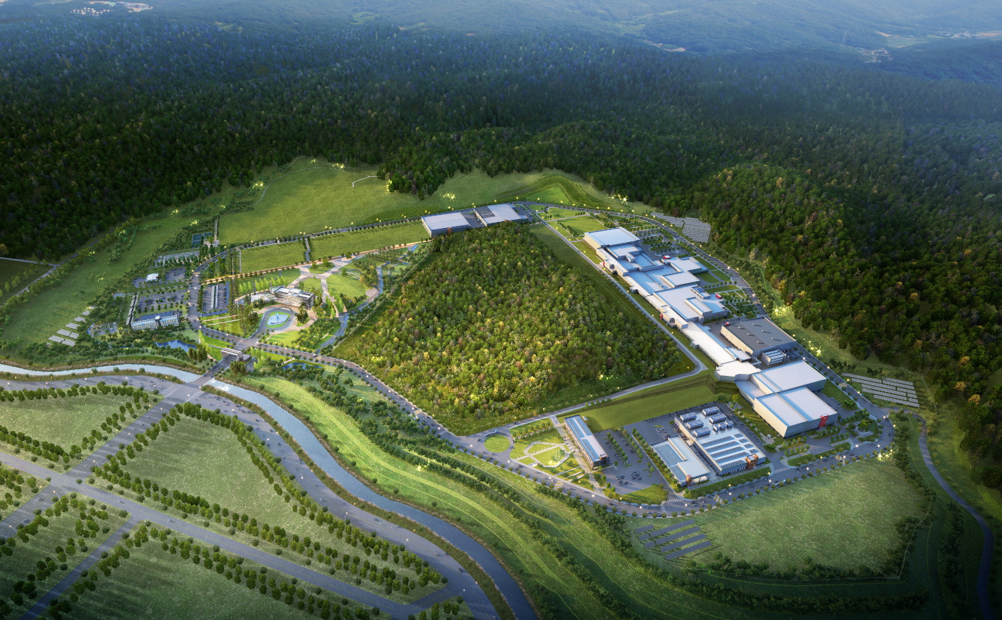
2. Construction
Building Layout
Building Layout
Campus Area : 952,066㎡ (including the reservation area of 144,640㎡)
Period : 2014 ~ 2021(8 years)
Cost : 996 billion won (incl. 357 billion won for land)
Building Area : 76,259㎡(11 Bds)
Total Bd. Area : 116,252㎡
Constructor : POSCO Consortium(11 companies)
Assembly Bd.
SRF Test Bd.
High Energy B
IF Separator / High Energy A
Waste Strorage
Cryogenics Bd.
HQ Office
Reservation
ISOL
SCL
Info. Center
Guest House
Low Energy A,B
Control Center
Utility Bd.
Electricity Bd.
Slide of M. Kwon

Slide 11
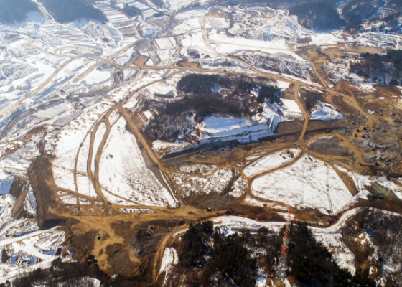
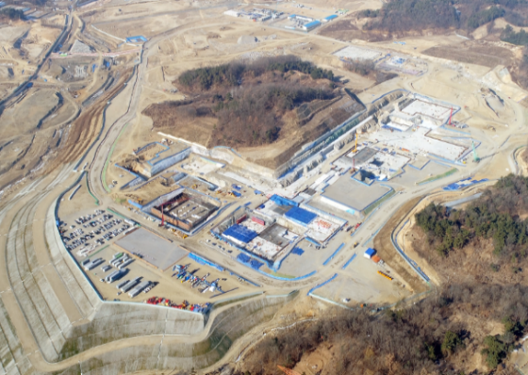
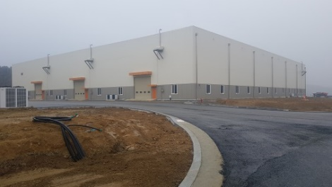
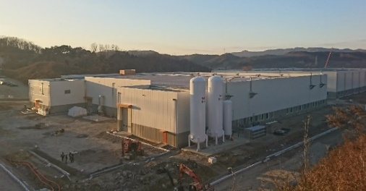
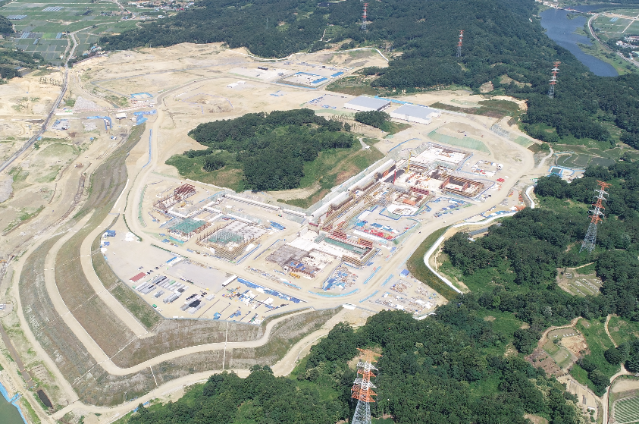
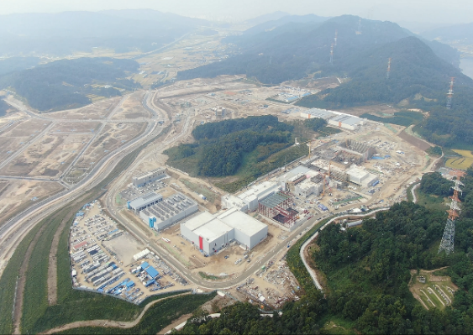
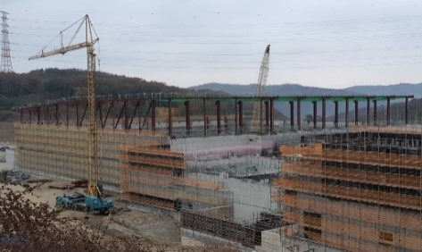
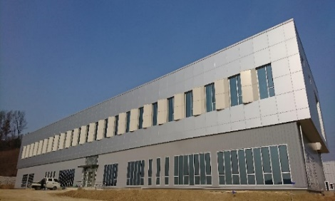
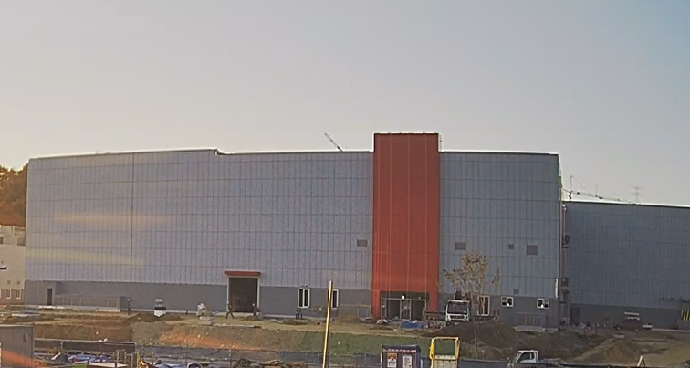
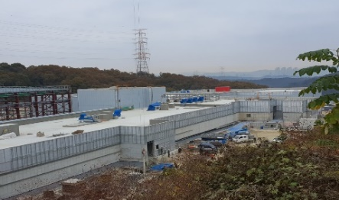
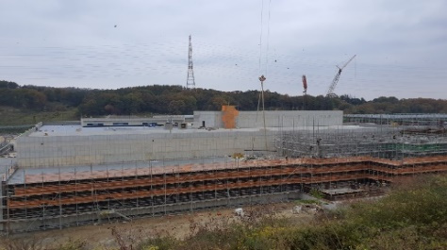
2. Construction
View of Construction Place
View of Construction Place (`19.10)
<Assembly Bd.>
<`17.01>
<`17.12>
<SRF Test Bd.>
<`18.6>
<`19.10>
<High Energy Exps.>
<Control Center>
<Low Energy Exps.>
<SCL3>
<ISOL>
Slide of M. Kwon

Slide 12
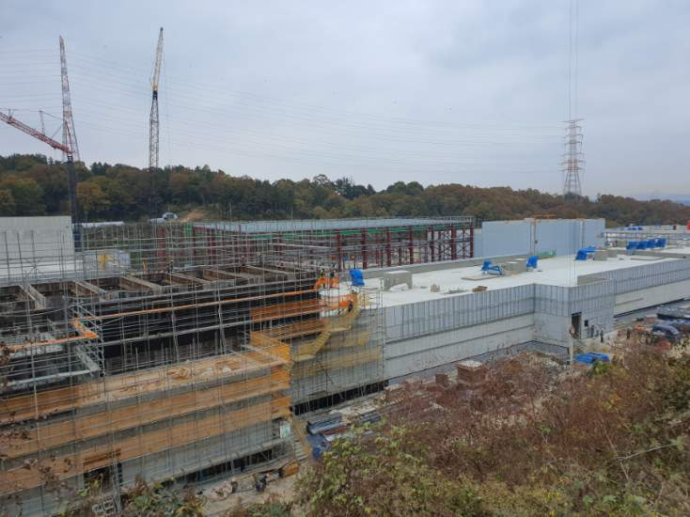
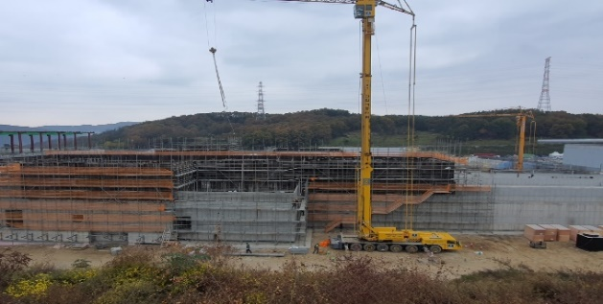
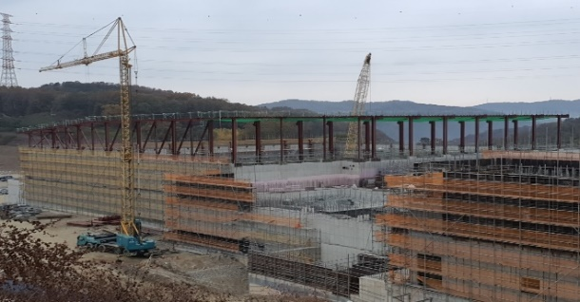
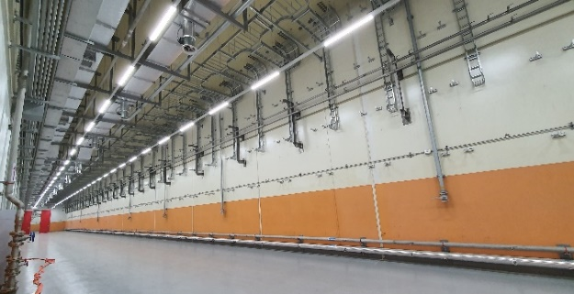
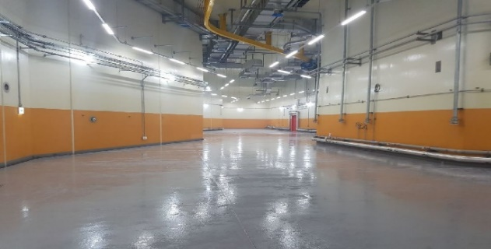
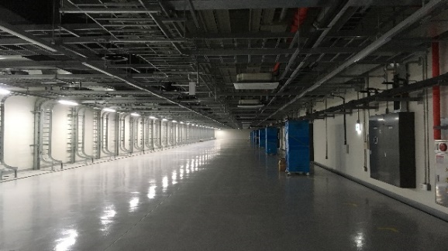
2. Construction
Conventional Facilities
SCL2
SCL3
Low Energy A/B
ISOL
IF/ High Energy A
High Energy B
SCL3
Bending Section
SCL3-gallery
Accelerator Bd.
Slide of M. Kwon

Slide 13
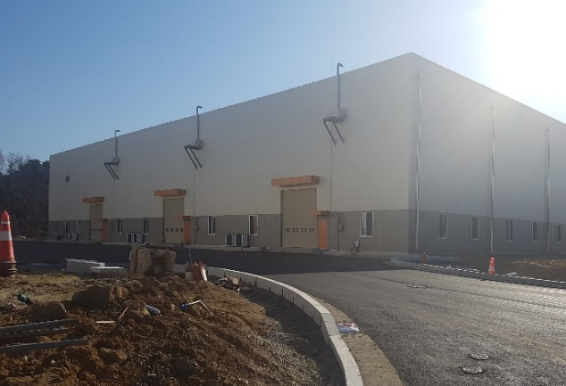
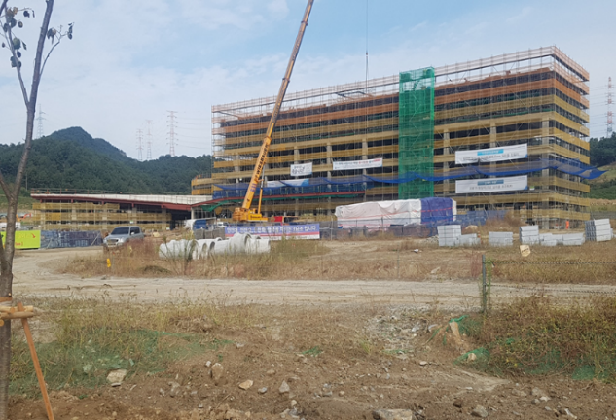
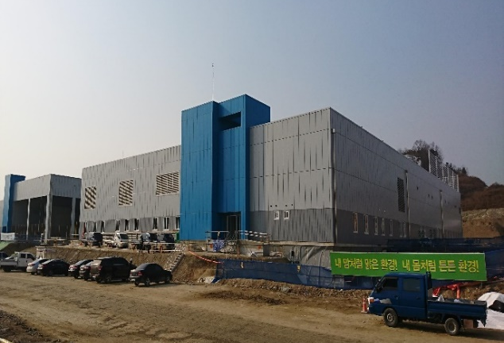
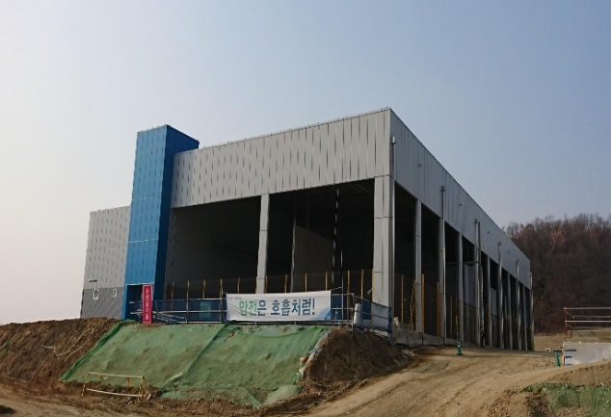
2. Construction
Conventional Facilities
SRF Test Bd.
Assembly Bd.
Control Center
HQ Office Bd.
Utility Bd.
Electricity Bd.
Slide of M. Kwon

Slide 14
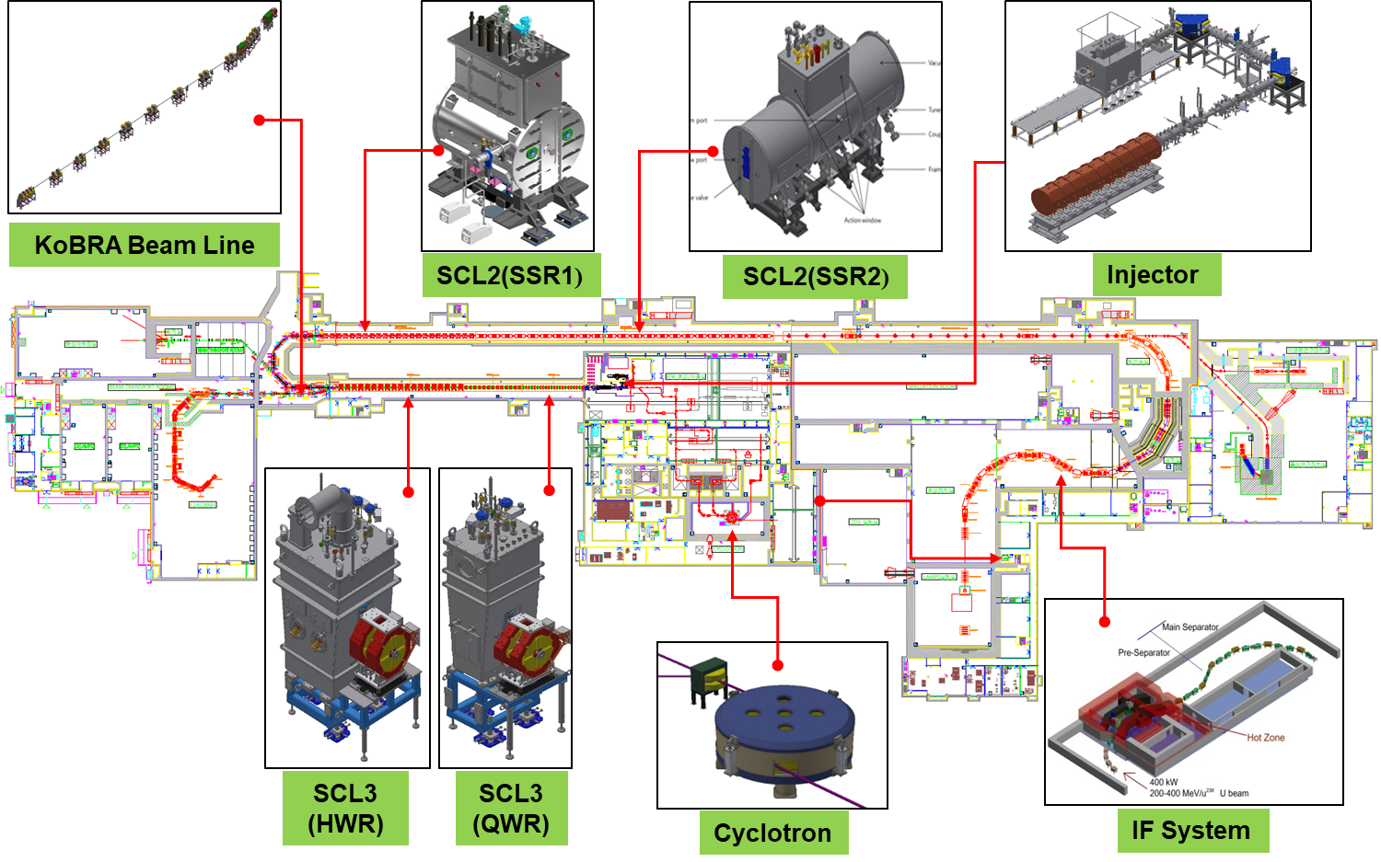
3. Sys. Install.
Accelerator System
Slide of M. Kwon

Slide 15
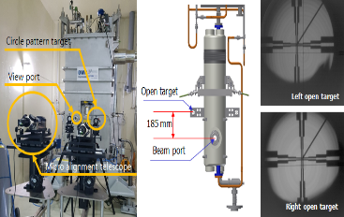
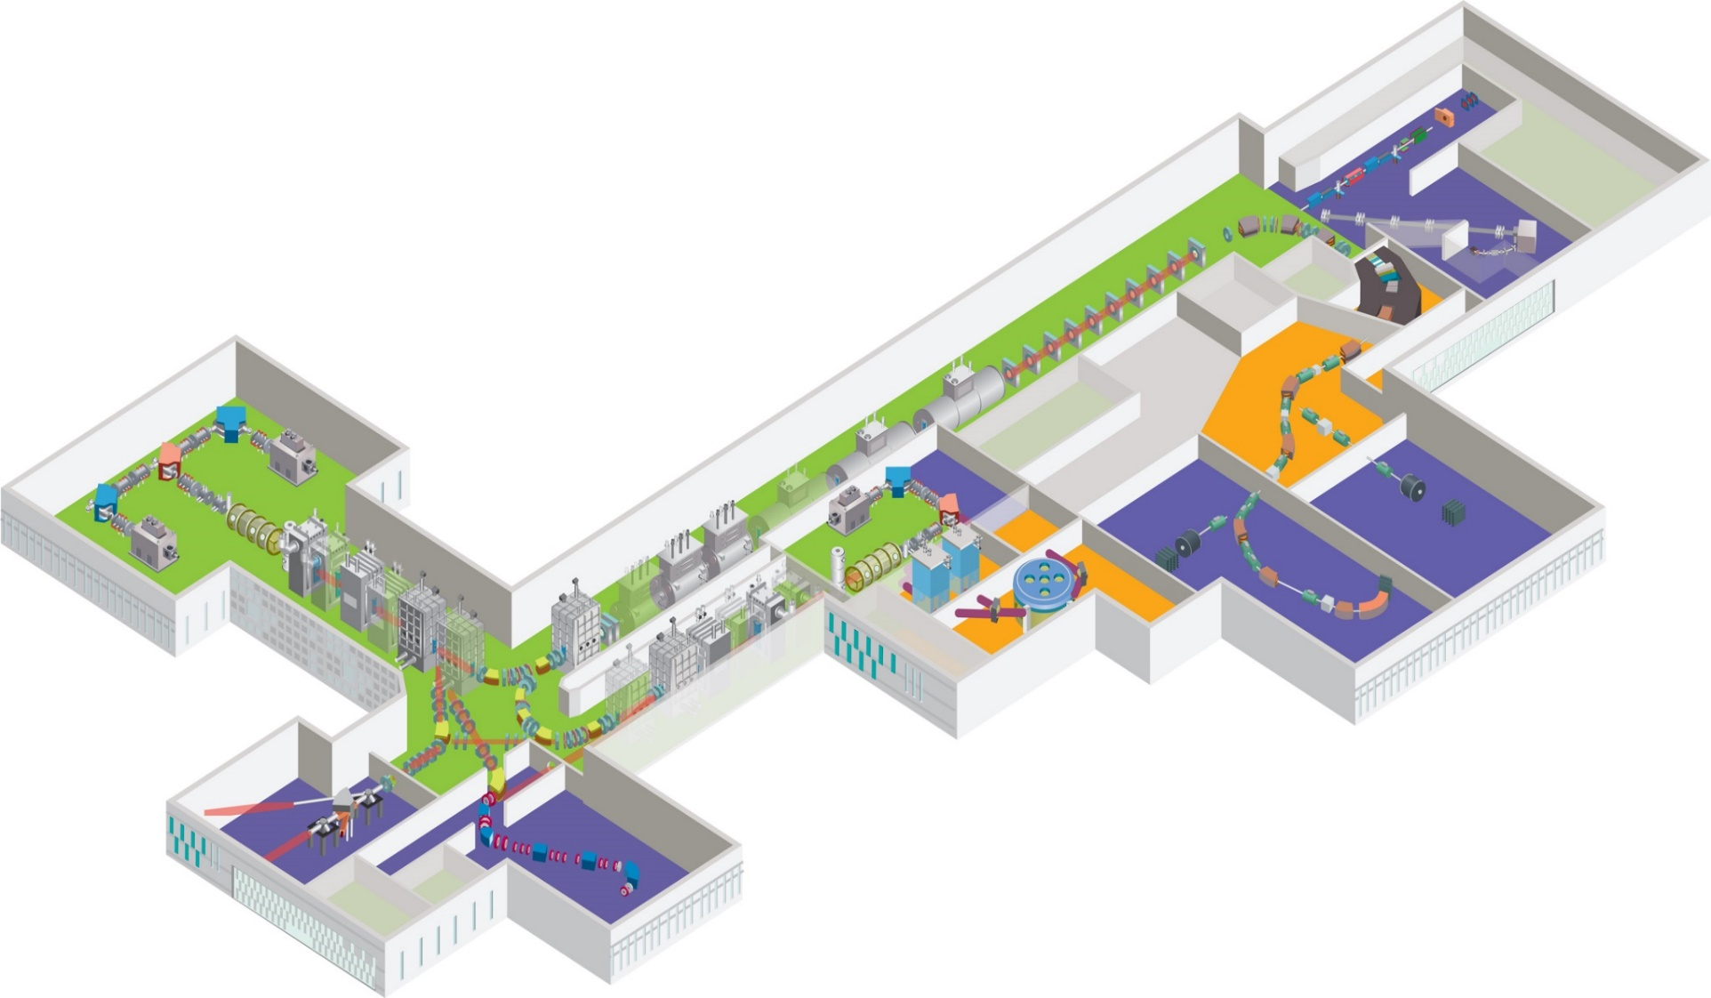
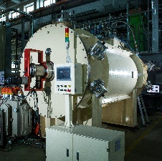
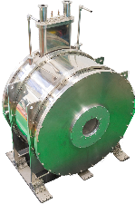
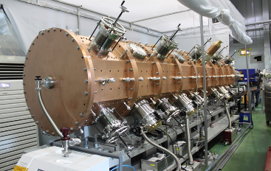
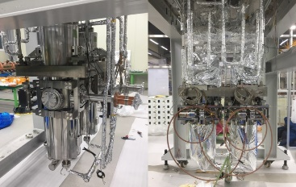
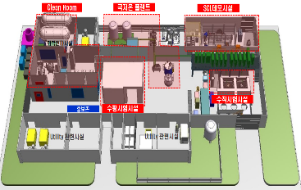
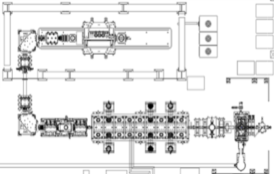
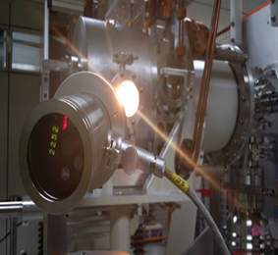
3. Sys. Install.
Major achievements in R&D
Achievement of low temperature test for LTS and HTS quadrupole prototype magnet (LTS 2017.11, HTS 2017.2)
QWR cryomodule test complete
(2017.05)
1st Oxygen Ion beam acceleration with RFQ(2016.12)
HWR cryomodule test complete
(2018.03)
1st Oxygen Ion beam acceleration with a QWR module, SCL Demo(2017.10)
High purity Sn beam extraction
using RILIS (2015.12)
Superconducting RF Test facility(2016.06)
ECR IS
RFQ
QWR
LEBT
MEBT
Slide of M. Kwon

Slide 16
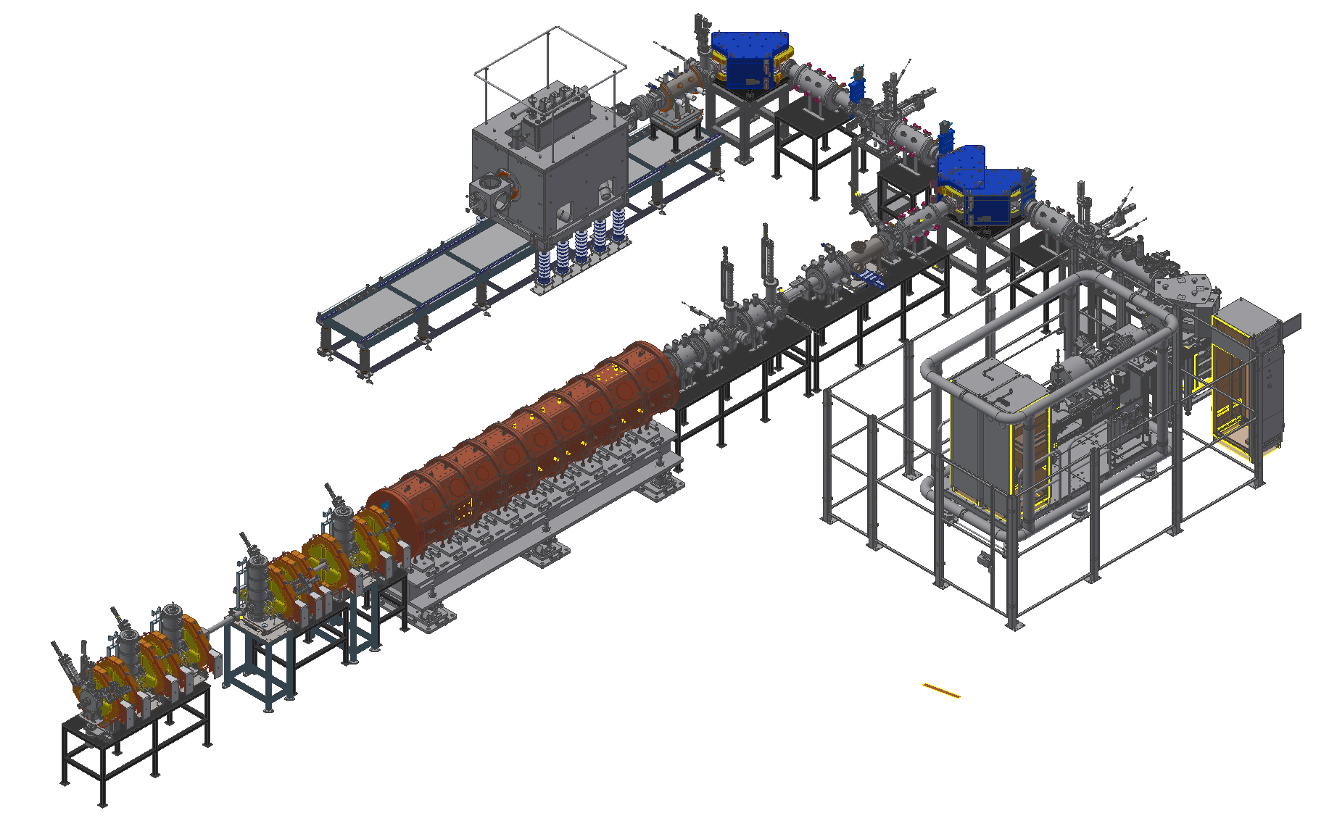
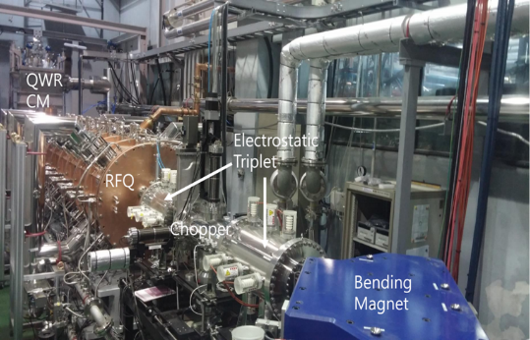
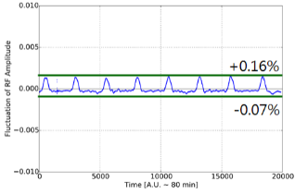
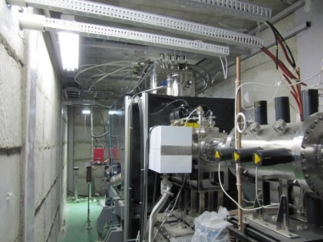
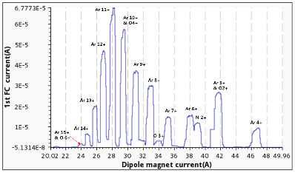
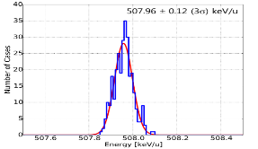
3. Sys. Install.
Accelerator System - Injector
Injector
SC ECRIS
∙ Two ECR ion sources on high voltage platforms
14.5 GHz ECR ion source
28 GHz superconducting ECR ion source
∙ LEBT (E = 10 keV/u)
Beam energy – 10 keV/u, Dual bending magnet
Chopper & Electrostatic quads, Instrumentation
∙ RFQ (E = 500 keV/u)
Frequency 81.25 MHz, Transmission Eff. ~98%
CW RF Power 94 kW (SSPA: 150 kW)
∙ MEBT (E = 500 keV/u)
Four RF bunchers (SSPA: 20, 15, 4×2 kW)
Simple quadrupole magnets, Instrumentation
LEBT
ECRIS
MEBT
RFQ
SC ECRIS commissioning
RFQ commissioning
∙ Beam experiment for the performance enhancement
∙ Basic metal beam experiment
∙ RFQ has been conditioned to 40kW, sufficient to
accelerate A/q=4.5 beams
Amplitude control of RFQ
Ar beam experiment
Charge distribution
QWR CM
ECRIS
Ar 11+ 70uA
RFQ
Output Energy of RFQ(TOF)
~508keV/u
Slide of M. Kwon

Slide 17
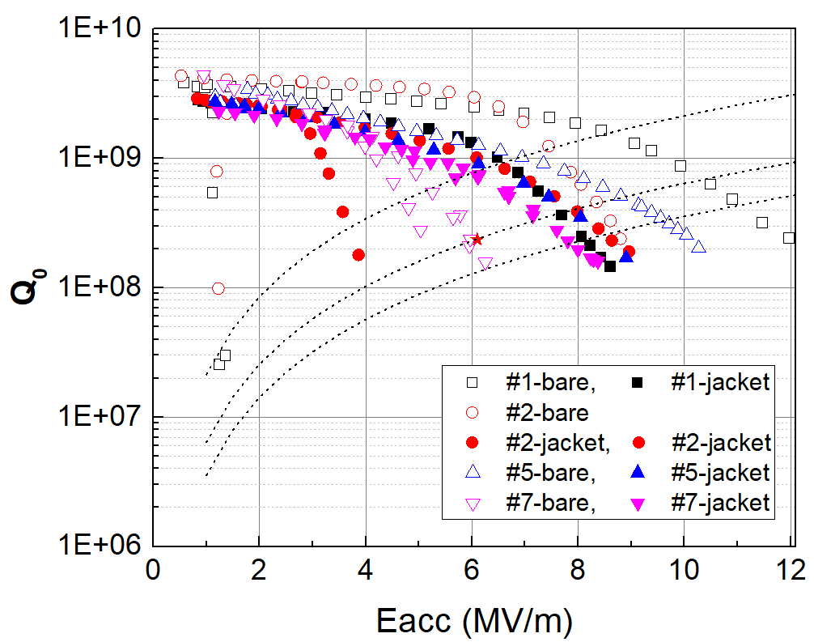
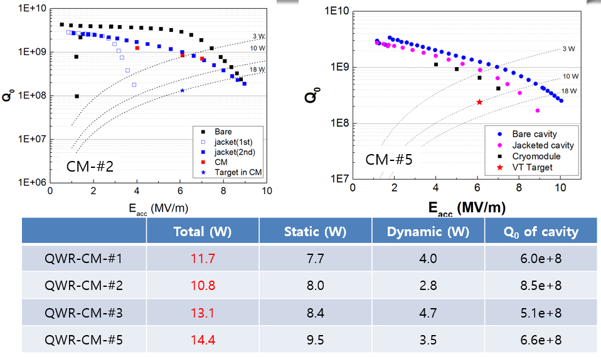
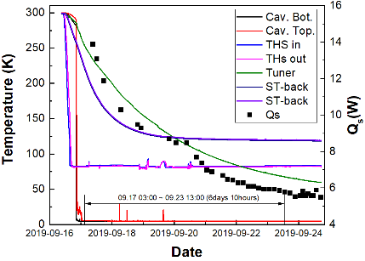
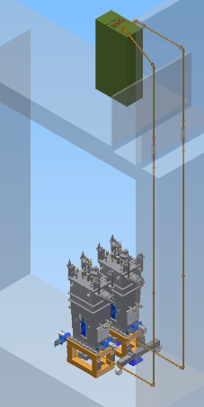
3. Sys. Install.
Accelerator System – SCL3
SCL31(QWR)
∙ Design performance was achieved with prototypes(2017.5)
∙ Oxygen beam was accelerated with injector and one QWR module(2017.10)
500 keV/u → ~700 keV/u, Successful long-tem operation of cryomdoule
∙ Mass production was contracted with domestic vendor(2017.12)
Pre-production cavities and cryomodules passed qualification, mass production is on-going
Total thermal load <20W@6.1MV/m, 4.2 K
VT target: 2.4e+8@6.1MV/m
RF System
∙ SSPA (4kW) : 2018.07~2020.05
Pre-production performance test(2019.11)
∙ HPRF transmission line (1-5/8”)
Installation vertical parts (2019.10)
∙ LLRF control system (2019.07~2020.06)
∙ RF reference line (81.25MHz) : ~2019.12
Static thermal load: 5.8 W
(Target: max. 7.5 W)
SCL32(HWR)
∙ Design performance was achieved with prototypes(2017.10)
Thermal load <14.1W@6.6MV/m, 2.1 K (HWR type A)
∙ Mass production was contracted with domestic vendor(2018.5)
QWR
HWR#A
HWR#B
Slide of M. Kwon

Slide 18
3. Sys. Install.
Accelerator System – SCL2
SCL21(SSR1)
∙ 1st prototype was performed by TRIUMF(2019.6)
Balloon type(less multipacting, better mechanical characteristics)
Accelerating gradient over 8.7MV/m, Multipacting below 2MV/m
∙ 2nd prototype with domestic vendor is on-going
RF System
∙ SSPA (8, 20 kW): 2020.01~2021.06
Requirement for RF power rating
∙ HPRF transmission line
3-1/8”, 4-1/16” rigid coaxial
∙ LLRF control system (2020.04~2021.06)
∙ RF reference line (81.25MHz) : ~2020.12
1st prototype by TRIUMF
2nd prototype by domestic vendor
SCL22(SSR2)
∙ 1st prototype of cavity is on-going
Designed by RISP, fabricated by domestic vendor
Balloon type, Deep drawing (depth ~280mm)
∙ 2nd prototype with IHEP is on-going
Cylindrical type
RISP design(balloon type)
Slide of M. Kwon
SSPA Prototype
SSR1

Slide 19
3. Sys. Install.
Accelerator System
Slide of M. Kwon

Slide 20
3. Sys. Install.
Accelerator System
Until September `2020
Slide of M. Kwon

Slide 21
4. NDPS
Experimental System
7 experimental systems
8 user groups
RAON-1 | KOBRA | Korea Broad Acceptance Recoil spectrometer & Apparatus | Kevin I. Hahn
RAON-2 | LAMPS | Large Acceptance Multi-Purpose Spectrometer | E. J. Kim
RAON-3 | MMS | Mass Measurement System/ Multi-Reflection Time-of-Flight | Andy K. Chae
RAON-4 | CLS | Collinear Laser Spectroscopy | J. B. Kim
RAON-5 | μSR | Muon Spin Relaxation/Resonance | K. Choi
RAON-6 | NDPS | Nuclear Data Production System | S. W. Hong
RAON-7 | BIS | Beam Irradiation System | W. Y. Park
RAON-8 | Theory | Nuclear Theory | M. K. Cheoun

Slide 22
Scientific program at early phase operation(candidate)
4. NDPS
Facility | Subject for early phase operation
KOBRA | ∙ Transfer reaction measurements in inverse kinematics (²⁹P(d,p)³⁰P, ²⁶Al(α,p)²⁴Si) ∙ Radiative capture reactions using batch mode RI beams (^{26g}Al(p,γ)²⁷Si) ∙ RI beam production via quasi-projectile-like fragmentation for ¹⁶O or ⁴⁰Ar
LAMPS | ∙ Ar+KCl or Xe+CsI in case of IF separator commissioning not completed
MMS | ∙ Isomer separation with using ^{26g.s.}Al and ^{26m}Al beams
CLS | ∙ Laser ionization and measurement of isomeric property for ²⁶Al
NDPS | ∙ Activation experiments with a quasi mono energy neutrons for light and heavy nuclei ∙ Surrogate reactions for fission
μSR | ∙ One of research areas of superconductivity and quantum magnetism with their scientific significance at the time of the μSR instrument completion
BIS | ∙ Physical dose distribution and linear energy transfer measurements with a ¹²C⁺⁶ beam (310 MeV/u)
Slide of M. Kwon

Slide 23
4. NDPS
Layout of Experimental System at RAON
Nuclear science - KOBRA, LAMPS, NDPS, MMS, CLS (based on atomic physics)
Applied science - μSR (Material science), BIS (Bio & Medical application)
7 (at the beginning of RAON operation) + upgrade + a (in the future, space reserved)
Slide of M. Kwon

Slide 24
4. NDPS
Other Accelerator-based neutron facilities in Korea
KIRAMS, Seoul
(p-Cyclotron)
Gil Hospital, Incheon
(BNCT)
RISP, Daejeon
(NDPS/TOF)
PAL, Pohang
(e-linac)
KAERI, Daejeon
(e-linac)
KAERI/KOMAC, Gyeongju
(p-linac, 200 MeV upgrade for soft error)
KAERI/ARTI, Jeongeup
(p-Cyclotron)
VIBA/KBSI, Busan
(ion-linac)
Dark Blue: In Operation
Red: Under Construction or Planning, R&D

Slide 25
4. NDPS
NDPS Facility
Nuclear Data Production System (NDPS) is an experimental system for measuring nuclear data by use of neutron Time-of-Flight detection systems.
RAON provides deuterons and protons up to 53 MeV and 88 MeV, respectively.
Pulsed beams with up to ~12 μA can be used to measure neutron-induced cross sections. The range of the beam repetition rate is to be 1 kHz ~ 1MHz. The beam width of the pulsed beams is aimed to be as small as 1~2 ns.
By using high energy neutrons, nuclear data such as fission cross section of actinides and (n, xn) cross sections can be measured at NDPS.

Slide 26
4. NDPS
NDPS Collaborators
Sangjin Lee (IBS/RISP)
Tae-Ik Ro (Dong-A Univ.)
Guinyun Kim (Kyungpook Univ.)
Min Goo Hur (KAERI)
C. H. Lee (KAERI)
Seunghyun Lee (KAERI)
Young-Ouk Lee (KAERI)
Tae-Young Song (KAERI)
Seung Dae Yang (KAERI)
Sung-Chul Yang (KAERI)
Moses Chung (UNIST)
Tae-Sun Park (SKKU)
Vivek Chavan (SKKU)
Seung-Woo Hong (SKKU)
Satoshi Chiba (Tokyo Tech)
Katsuhisa Nishio (JAEA)
Nobuhiro Shigyo (Kyushu University)
Yukinobu Watanabe (Kyushu University)
Hiroshi Yashima (Kyoto University)
Peter Schillebeeckx (GELINA, JRC)
and more
Open to any foreign users !

Slide 27
4. NDPS
NDPS Facility
SCL3
NDPS budget : 3,000,000,000 KRW ~ 3M US$

Slide 28
4. NDPS
NDPS Parameters
Neutron Production Characteristics
Neutro energy | <~53 MeV (white), <~88 MeV (mono-energetic)
Neutron flux | ~2 X 10^12 nuetron/sr/μC (white)
Beam pulse rep. rate | 1 kHz ~ 1 MHz
Beam pulse width | 1~2 ns
Accuracy | <10%
Target and Dector System
Thick target | C: < 10 mm
Thin target | Li: < 5 mm
Neutron collimator | Fe + PE
Neutron beam dump | Concrete
Proton beam dump | Cu
Detector | n-TOF system (with plastic dectectors) Fission cross-section detector

Slide 29
4. NDPS
Preliminary Simulations
d + C/Be (white)
p + Li (quasi mono-energetic)
x 10
8
Li 20mm Li 15mm
2
Li 5mm
Count, n/sr/uC
Li 0.5mm
1.5
1
11.5MeV
10.1MeV
0.5
8.5MeV
0
0
20
40 60 80
100
Energy, MeV
8
Determination of proper thickness
₁₄ x 10
Li 5mm
88MeV+Li (5mm) 70MeV+Li (5mm) 50MeV+Li (5mm) 30MeV+Li (5mm)
12
Counts, n/sr/uC
10
8
6
4
2
0
0
10 20
30
40 50 60 70
80
90
Energy, MeV
Simulation of Neutron spectra at 0° and angular distribution
p + Li (Quasi-mono energetic)
McDeLi and the McDcBe codes used for d+C reaction.

Slide 30
4. NDPS
Possible initial experiments
Measurements of (n,xn) reactions with quasi mono energy neutrons by activation technique
²⁰⁹Bi(n, 4n)
⁵⁹Co(n,xn), ⁹³Nb(n,xn), ¹⁹⁷Au(n,xn), ²⁰⁹Bi(n,xn)
Fission cross section measurements for heavy elements (Pb, Bi, etc.) or actinides
Activation experiments induced by light or heavy ions
Surrogate reactions for fission

Slide 31
4. NDPS
NDPS construction consortium has been formed
KAERI
UNIST
SKKU
Neutron Production
Beam Delivery
(1) Thick target
(6) Beam line
(8) Single bunch system
(9) Detectors
(2) Thin target
(7) Vacuum
(3) Collimator
(4) Neutron dump
(5) Proton dump

Slide 32
4. NDPS
NDPS construction consortium team
At the experimental hall
At the target room

Slide 33
4. NDPS
Project Schedule
 | 2019 | 2020 |  |  |  | 2021
 | 4Q | 1Q | 2Q | 3Q | 4Q | 1Q | 2Q | 3Q | 4Q
Target system
Beam delivery system
Collimator
Dump
Vacuum
Single bunch system
Detector system
Report
Design
Fabrication
Installation
33

Slide 34
Summary
RAON will provide great research opportunities not only in nuclear physics, but also in applied sciences such as material, bio-medical sciences, and nuclear data.
NDPS is under construction for setting up experimental flatform for n-TOF and fission cross-section measurements.
Day-1 experiment for NDPS is under discussion.
NDPS will be prepared for use in 2022.
NDPS construction consortium has been officially formed in this November.
We need international collaborations to make the best use of the facility. Please join us!

