Slide 1

A Consideration on Nuclear Data Needs for 1F Decommissioning
Tokio Fukahori
Japan Atomic Energy Agency

Slide 2
Nuclear Data Needs for 1F Decommissioning
Japan Atomic Energy Agency
Summary
  Quantities Related to Fission Reaction
  Fission Yields
  Decay and Nuclear Structure Data
  Total Cross Section for Structural Materials
  Activation Cross Section for Structural Materials
  High Energy Gamma Production from Capture State
  Emitted Particle Spectra (especially for Alpha-particle)

Slide 3
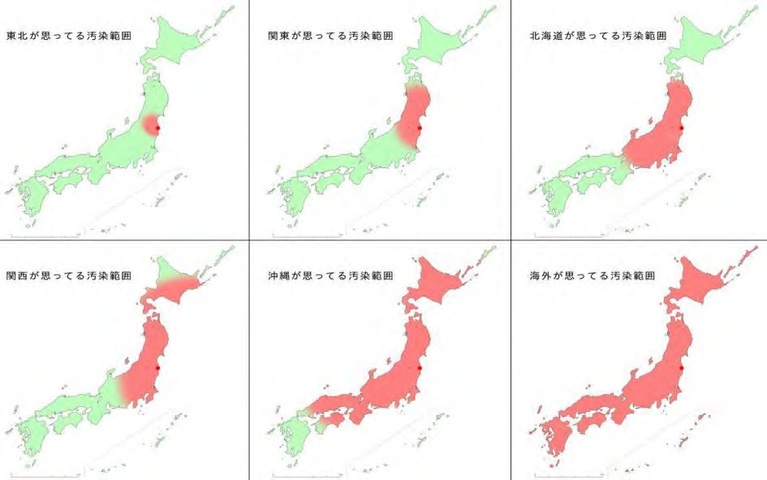
Now I am working for Fukushima!
Japan Atomic Energy Agency
Where is the affected area people think?
From abroad
http://www.yukawanet.com/archives/3930193.html

Slide 4

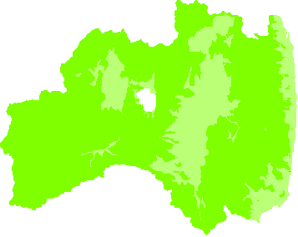

Now I am working for Fukushima!
Japan Atomic Energy Agency
Berlin
Hong Kong
Seoul
New York
0.07
0.15
0.12
0.05
2018. 1
2018.2
2018. 1
2018. 1
（Unit: μSv/h ）
Tokyo
0.04
2018. 11
London
0.11
Beijing
2018. 1
Singapore
0.07
Fukushima
0.14
Minami-Soma
0.10
2018. 1
0.07
2018. 1
●
●
0.05
●
0.09
0.11～8.72
Aizu-Wakamatsu
●
Koriyama
●
Real Data for Dose Rate
0.04
Ohkuma
●
Minami-Aizu
●
Shirakawa
2018.11
0.07
0.06
●
Iwaki
出典：福島県放射能測定マップより（国外各都市の値は日本政府観光局の公表値） ※県内の値は2018年11月12日現在。

Slide 5
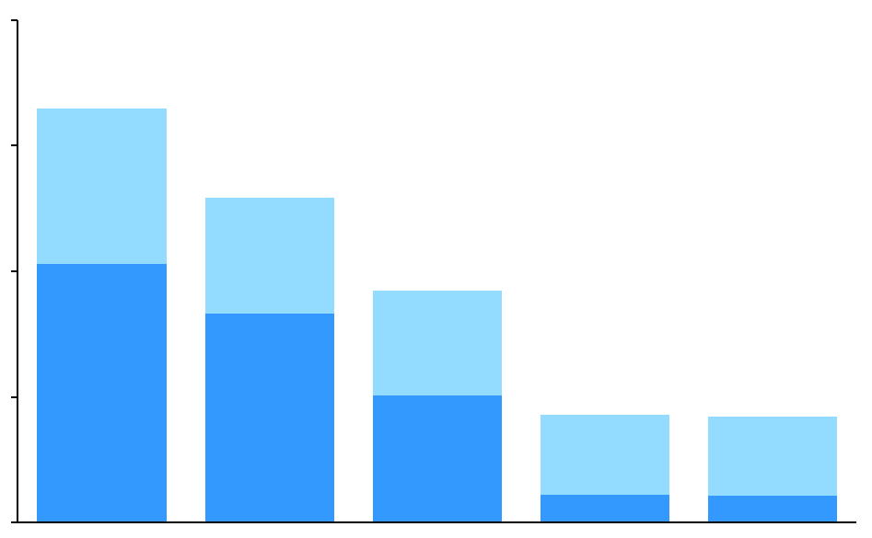
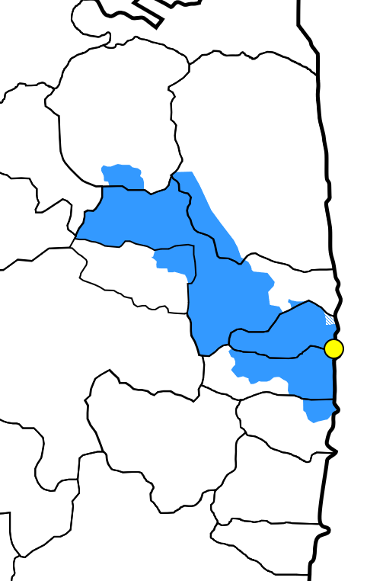
Now I am working for Fukushima!
Japan Atomic Energy Agency
Evacuation
Evacuees
Evacuation-Designated zones
( )
unit : person
200,000
Evacuees inside the prefecture
August 8, 2013
April 10, 2019
164,865
Evacuees outside the prefecture
8.3% area
2.5% area
150,000
129,154
100,000
92,154
Fukushima
Daiichi NPS
Fukushima
Daiichi NPS
Fukushima
Daiichi NPS
Fukushima
Daiichi NPS
50,000
42,929
42,122
20km
radius
0
May
2012
May
2014
May
2016
May
2018
October
2019
Difficult-to-Return zone
Restricted residence zone
Edited from “Steps for Revitalization in Fukushima 26th edition
<August 5, 2019>” and “Damage Report <October 7, 2019>”. (Fukushima Prefecture) (accessed 2019/10/24)
Evacuation order cancellation preparation zone
Edited from “Steps for Revitalization in Fukushima 26th edition <August 5, 2019>”. (Fukushima Prefecture) and “Evacuation Areas”. (Ministry of Economy, Trade and Industry of Japan) (accessed 2019/10/24)

Slide 6
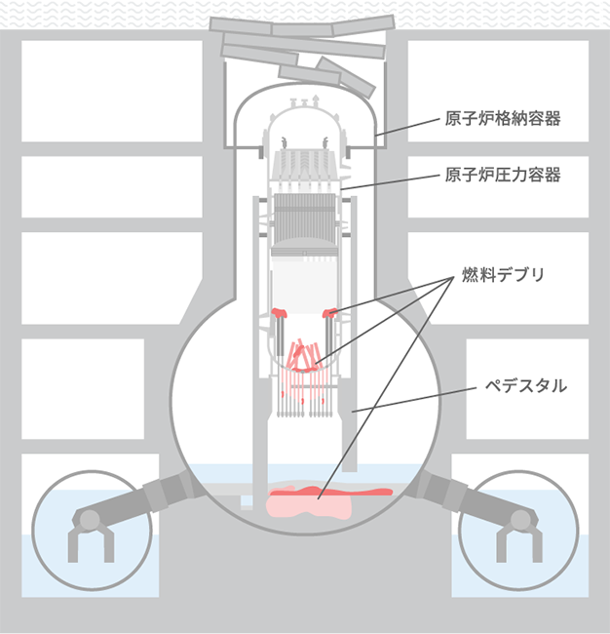
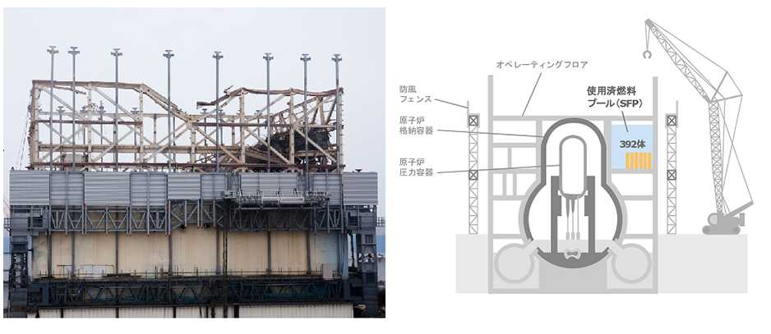
Now I am working for Fukushima!
Japan Atomic Energy Agency
Major Milestones and Current Situation of Unit 1
Primary
Containment
Vessel
Pressure
Vessel
Debris
Pedestal
http://www.tepco.co.jp/decommission/progress/retrieval/
http://www.tepco.co.jp/decommission/progress/removal/index-j.html

Slide 7
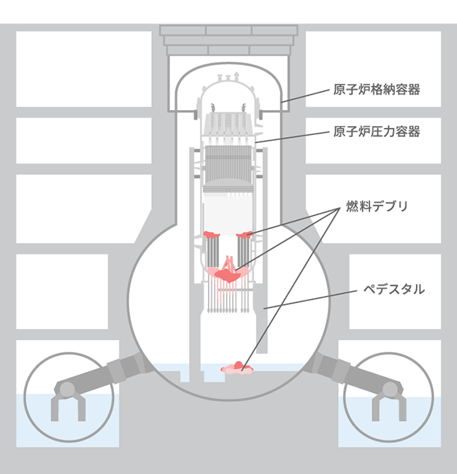
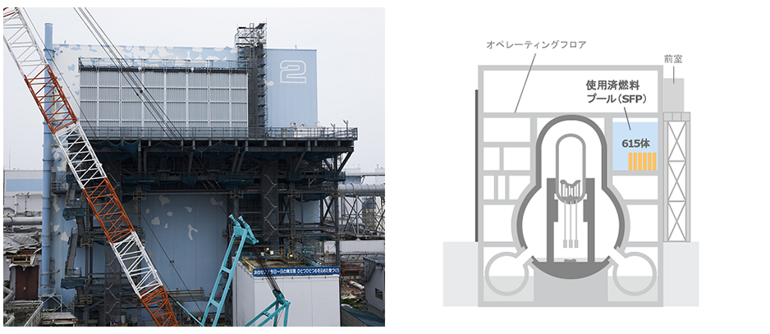
Now I am working for Fukushima!
Japan Atomic Energy Agency
Major Milestones and Current Situation of Unit 2
Primary
Containment
Vessel
Pressure
Vessel
Debris
Pedestal
http://www.tepco.co.jp/decommission/progress/retrieval/
http://www.tepco.co.jp/decommission/progress/removal/index-j.html

Slide 8
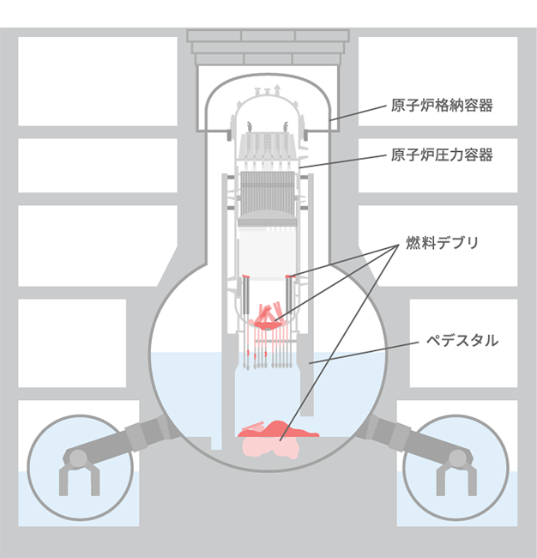
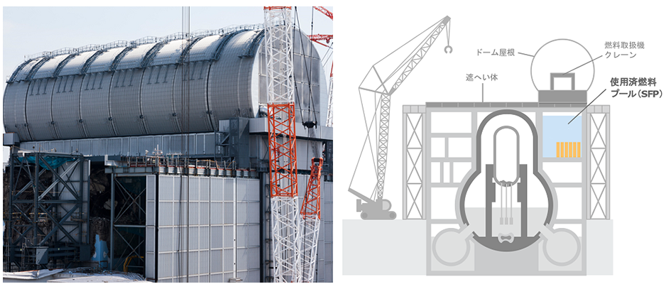
Now I am working for Fukushima!
Japan Atomic Energy Agency
Major Milestones and Current Situation of Unit 3
Primary
Containment
Vessel
Pressure
Vessel
Debris
Pedestal
http://www.tepco.co.jp/decommission/progress/retrieval/
http://www.tepco.co.jp/decommission/progress/removal/index-j.html

Slide 9
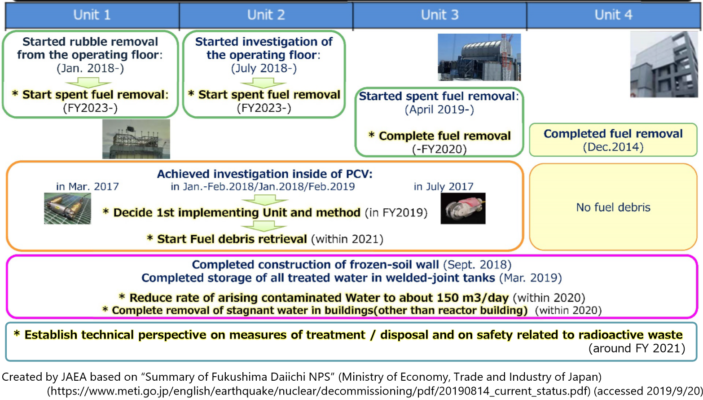
Now I am working for Fukushima!
Japan Atomic Energy Agency
Major Milestones and Current Situation of Unit 1-4

Slide 10
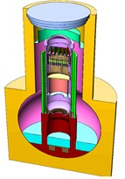
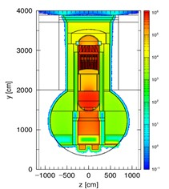
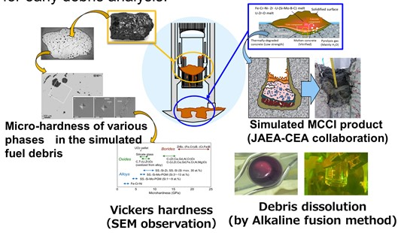

CLADS –R&D Examples- (1/2)
Japan Atomic Energy Agency
Evaluation and Simulation
Fuel Debris Characterization
Evaluation of dose distribution
【Objective】 Estimation of the characteristics of fuel debris in the reactor using simulated fuel debris, and establish methods for handling and analysis of actual debris towards decom-missioning work for the removal and storage of fuel debris.
【Main research theme】
(1) Evaluation of fuel debris characteristics in the reactor
Estimate the characteristics considering the idiosyncratic reactions of Fukushima Daiichi NPS, and update with the latest information.
(2) Analytical technologies for fuel debris
Establish analytical technologies and transportation method to develop a system for early debris analysis.
【Objective】 Contributing to the optimization of decom-missioning procedures and to nuclear material accountancy of retrieved fuel debris.
【Main research theme】
・Evaluation of dose distribution
Evolution of the dose rate distribution in PCV of Fukushima Daiichi NPS based on simulation of accident, experiments and measured values in internal investigations.
Reflection of available output of
JAEA, TEPCO, IRID, OECD/NEA, etc.
・Fuel burnup calculation,
・Activation calculation,
・Accident progression analysis,
・PCV/RPV internal investigation,
・FP behavior experiment,
・Fuel debris characterization, etc
International
Cooperation
International
Cooperation
Calculation of 3D-dose
rate distribution
(Monte Carlo calculation
code PHITS)
Evaluation of dose rate
distribution in PCV

Slide 11
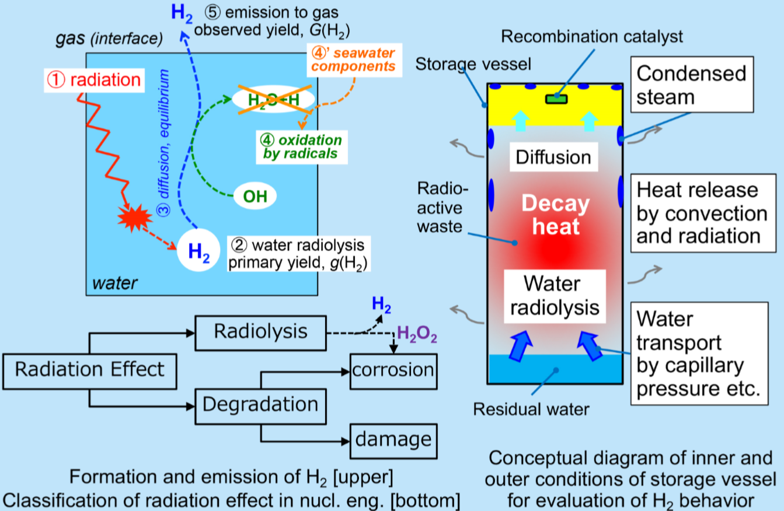
CLADS –R&D Examples- (2/2)
Japan Atomic Energy Agency
Radiolysis of Waste and Fuel Debris

Slide 12
Nuclear Data Needs for 1F Decommissioning
Japan Atomic Energy Agency
Understanding Accident Development
Final Burn-up (= Ordinally Burn-up Calculation)
  Quantities Related to Fission Reaction
  Fission Yields
  Decay Data
I think current nuclear data have enough accuracy.
Fuel Debris Composition (Melted Materials’ Transfer)
  Fission Yields
  Decay Data
Heat Reduction
  Fission Yields
  Decay and Nuclear Structure Data

Slide 13
Nuclear Data Needs for 1F Decommissioning
Japan Atomic Energy Agency
Understanding Current Situation inside Reactor
Source Term
  Quantities Related to Fission Reaction
  Fission Yields
  Decay Data
Criticality Management
  Quantities Related to Fission Reaction
  Fission Yields
  High Energy Gamma Production from Capture State → Capture Credit
Heat Reduction
  Fission Yields
  Decay and Nuclear Structure Data
Radiation Shielding
  Fission Yields
  Total Cross Section for Structural Materials
  Decay and Nuclear Structure Data

Slide 14
Nuclear Data Needs for 1F Decommissioning
Japan Atomic Energy Agency
Waste Management of Rubble and Fuel Debris
Criticality Management
  Quantities Related to Fission Reaction
  Fission Yields
Fuel Debris Composition and Radiation Production
  Fission Related Nuclear Data for Burn-up Calculation
  Fission Yields
  Activation Cross Section for Structural Materials
Radiation Shielding and Heat Reduction
  Fission Yields
  Decay and Nuclear Structure Data
  Total Cross Section for Structural Materials
Radiolysis
  Fission Yields
  Decay and Nuclear Structure Data
  Emitted Particle Spectra (especially for Alpha-particle)

Slide 15
Nuclear Data Needs for 1F Decommissioning
Japan Atomic Energy Agency
Summary
  Quantities Related to Fission Reaction
  Fission Yields
  Decay and Nuclear Structure Data
  Total Cross Section for Structural Materials
  Activation Cross Section for Structural Materials
  High Energy Gamma Production from Capture State
  Emitted Particle Spectra (especially for Alpha-particle)

Slide 16

Thank you for your attention!
is your good choice.
Peace of nuclear data with you!
Notes:
As a starting point of discussion

